Slide 1














Asset
Management:

Slide 2


Introduction to Asset Management
E-Asset Management System is a powerful solution designed to revolutionize asset management and tracking .
Efficiently managing a range of assets.
Help Borrowers for their undisrupted flow of work.

Slide 3






Problem Statement
A web-based E-Asset Management System to streamline tracking, enhance accountability, and optimize asset management processes.
Current asset management practices are inefficient and error-prone, leading to suboptimal resource utilization and increased operational costs.

Slide 4
Work Flow
Firstly, User Login/Registration Page will appear
There are two types of Users:
Admin (Only one)
Borrower
Login by entering the Credentials
Admin is already Registered and If Borrower doesn't exist then Register first
Landing Page appears

Slide 5
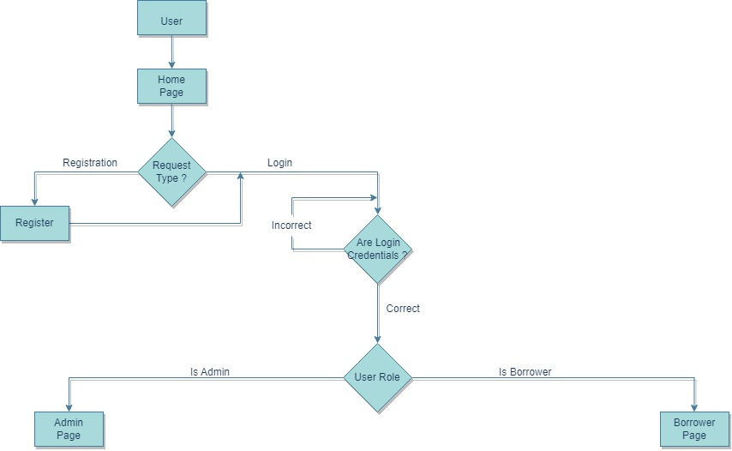
Landing Page

Slide 6
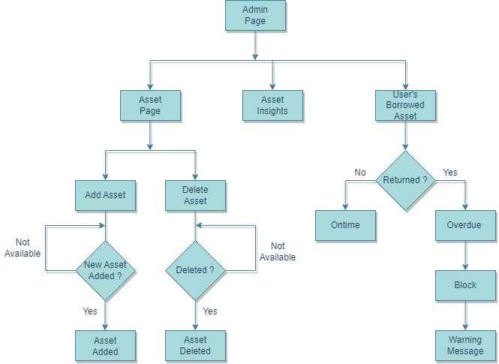
Admin's Page

Slide 7
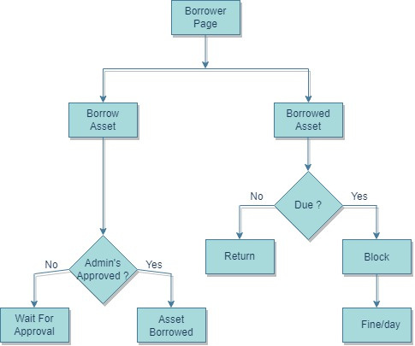
User's Page

Slide 8

Future Scope
Machine learning can also enhance anomaly detection for security purposes.
Expand Asset Types
Feedback Mechanism

Slide 9



Thank you!

